Slide 1
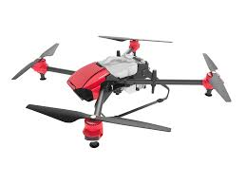
AMELIORATING EFFECT OF POTASSIUM (K) ON SUGARCANE CROP AT THE GRAND GROWTH STAGE THROUGH DRONE AERIAL SPRAYING AIDED WITH SATELLITE IMAGERY FOR ANALYSIS
Presented By: Azeem Haider (Ph.D)

Slide 2
INTRODUCTION:
Sugarcane is potassium hungry crop that is an essential primary nutrient for the growth of sugarcane and the amount of K present in the plant affects the quality & quantity of sugar produced (Bhatt et al. 2021; Junior et al. 2013)
Application of fertilizers to the crop largely depends on the farmers’ financial positions, availability of water, fertilizer and equipment, and profits earned (Malik, 2016)
Unmanned aerial vehicles (UAV’s) or drones have become popular in precision agriculture (PA). They are used for spraying, mapping and monitoring cropping areas using image processing (Rasheed et al. 2021; Moazzam et al. 2021)
Resources such as Sentinel, MODIS, and LANDSAT satellite imagery helps in monitoring crops very efficiently. Regular analysis of the crop field can help in monitoring all the factors that can affect a crop negatively, can help in applying chemicals only to the required areas, can help in achieving better yields
This paper presents the effectiveness of potassium applied to sugarcane at the grand-growth stage carried out through aerial spraying drones

Slide 3
OBJECTIVES:
Our research is divided into primary and secondary objectives
The primary objective has two parts
The first part is the application of foliar Potassium at the grand-growth stage and analyzing the effect on the yield, recovery and profit
The second part is using a drone for the spray to achieve sustainability since the crop gets chemical application only at the required parts and is not mixed into the soil. Through this, we aims to achieve cost-effectiveness, water-saving, and quick absorption of Potassium
The secondary objective is the monitoring of crop health, water levels, heat stress, and any other environmental change through satellite imagery analysis
This paper presents the experiments conducted on three sugarcane varieties namely: CPF-251, CPF-253, and CP77- 400. CPF-251 and CP77-400 are early maturing varieties of Punjab while CPF253 is a medium maturity variety

Slide 4
MATERIALS & METHODS:
The study was conducted during the 2020-21 season in SSM, Chiniot district, Punjab, Pakistan in a study area identified geographically as 31°49’16.7"N and 72°50’03.0"E
The soil of this area is sandy loamy and samples were taken before the plantation revealed medium-fertility of the soil with an average of available potassium lying between 110-120 𝑚𝑔∕𝑘𝑔
The climate in this area is usually hot in the summers. Figure 2 shows the average monthly maximum and minimum temperatures, rainfall, relative humidity, precipitation, and wind speed during the study period
Three sugarcane cultivars (CPF-251, CPF-253, and CP77-400) were planted in February 2020
Treatments were foliar applied K (30% at 2.5 L∕ha and a control (no K) in demonstration-type plots without randomization but replication

Slide 5
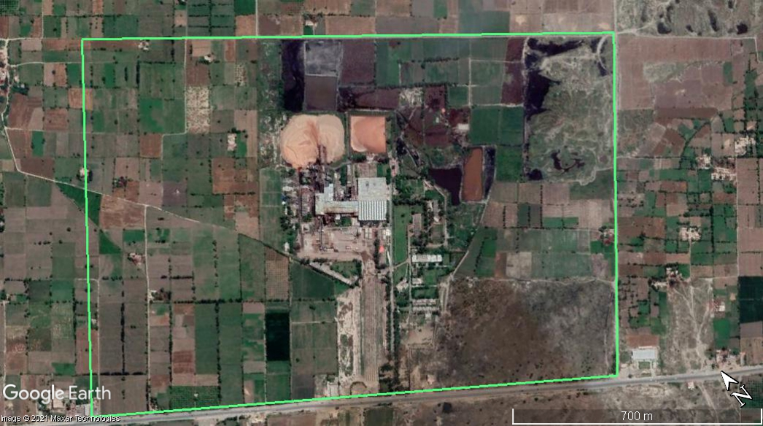
Figure 1: The study area for this study located at 31°49’16.7"N 72°50’03.0"E.

Slide 6
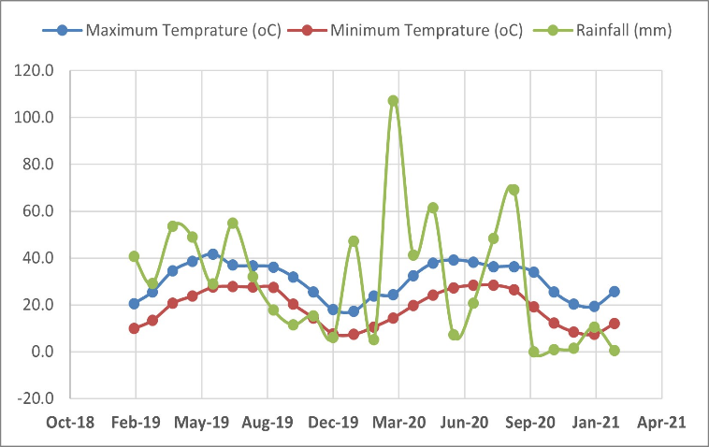
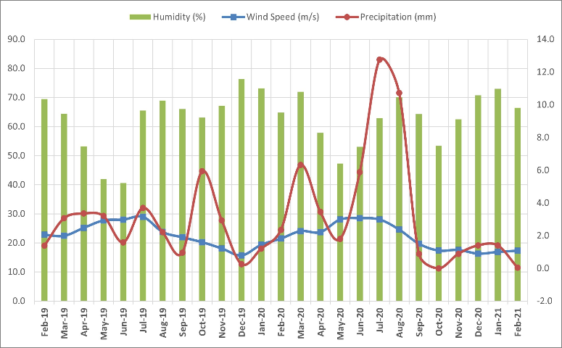
Figure 2: Monthly average of the following parameters are shown for the study area from 2019-2021: (a) Maximum temperature, Minimum temperature and Rainfall, and (b) Humidity, Precipitation and Wind-speed
During the study period, the site received a total of 374 mm rain with maximum temperature ranging 39.1 C – 19.3 ⁰C and minimum temperature between 28.5 C -7.5 ⁰C
The average wind speed was 2.0 m/s with a maximum value of 3.1 m/s, average humidity was 63.7% with a maximum value of 73%

Slide 7
MATERIALS & METHODS:
Harvesting was completed by January 2021.
Eight to ten tons of seedcane/ha were planted with a row-spacing of 75 cm.
We used remote sensing to aid us with the analysis of the crop throughout its growth cycle.
Sentinel-II satellite imagery was used for monitoring crop health, water stress analysis, heat stress analysis, nitrogen (N) deficiency and soil analyses.
Four parameters were used for the analysis namely
Normalized Difference Vegetation Index (NDVI) (Wiegand et al. 1991)
Modified Soil Adjusted Vegetation Index (MSAVI) (Qi et al. 1994)
Normalized Difference Water Index (NDMI) (Vermote et al. 2016)
Normalized Difference Red Edge Index (NDRE) (Vermote et al. 2016)

Slide 8
RESULTS:
As treatments were neither randomized nor replicated, statistical analyses were not possible. The yield, sugar recovery and economic data is therefore not definitive but rather indicated possible trends.
Health and physical attributes of the crop
Potassium from the foliar applications appeared to be taken up through the leaves and resulted in an improved physical appearance of the plant.
This was reflected in plant vigor, health, crop height, leaf erectness, and leaf color of the treated cane compared to that of the control plots.
Figure 4 shows the cane in the control and treated plots for each cultivar i.e. CPF251, CPF253, and CP44-700 respectively after harvesting

Slide 9
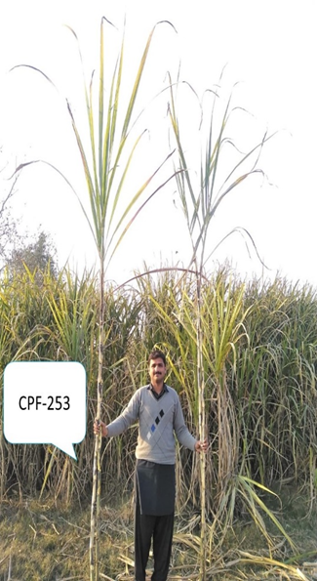
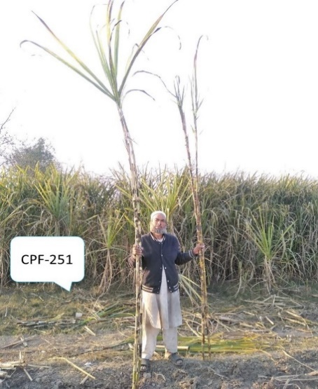
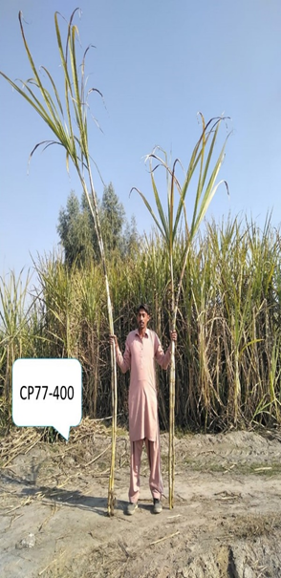
Figure 4: Field images of harvested canes of each variety. left cane is the treated cane while right cane is the harvest of control plot. (a) CPF251, (b) CPF-253, and (c) CP77-400

Slide 10
RESULTS:
Yield of control vs treated plots
Cultivar CPF-253 produced about 83 tc/ha in the control plot and an average of 89 tc/ha in the treated plots. The highest value obtained was 108 tc/ha.
Cultivar CPF-251 produced 86 tc/ha in the control plot and an average of 92 tc/ha in the treated plots. The highest value obtained was 101 tc/ha.
Cultivar CP 77-400 produced 83 tc/ha in the control plot and an average of 85 tc/ha in the treated plots. The highest value obtained was 97 tc/ha (figure 5).
Figure 5: Average yield (tc/ha) of all three varieties for control and treated plots.

Slide 11
RESULTS:
Sugar Recovery and Analysis
Sugar recovery is one of the most important aspects of sugarcane. Our experiment showed possible increase in sugar recovery following treatment with K (Figure 6).
Cultivar CPF-251 appeared to respond best to the treatment, followed by CPF-253 and CP77-400.
Figure 6: Percentage increase in sugar recovery (%) as compared to the control

Slide 12
RESULTS:
Yield and Economic Analysis
A combined analysis of financial and production benefits is shown in Figure 7. As we can see that an incremental benefit of 7.6% is observed for CPF-253, 7.1% for CPF-251, and 2.5% for CP 77-400
Similarly, a financial benefit of 7.9% is observed for CPF-253, 7.7% for CPF-251, and 3% for CP 77-400
Figure 7: Incremental benefit per acre and average yield impact as compared to the control plots.

Slide 13
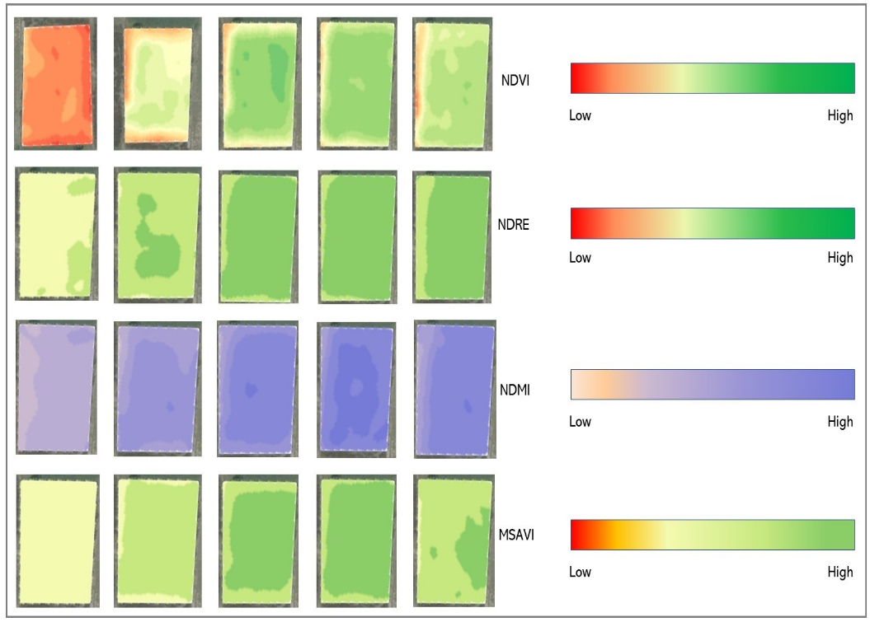
RESULTS (Satellite Imagery Indices):
Health of the crop & any sudden changes
Monitor Nitrogen content
Water situation of the crop
Change in vegetation along with NDVI
Figure 8: Vegetation indices for different stages of crop from sowing to maturity. The right side shows the corresponding color range of each index.

Slide 14
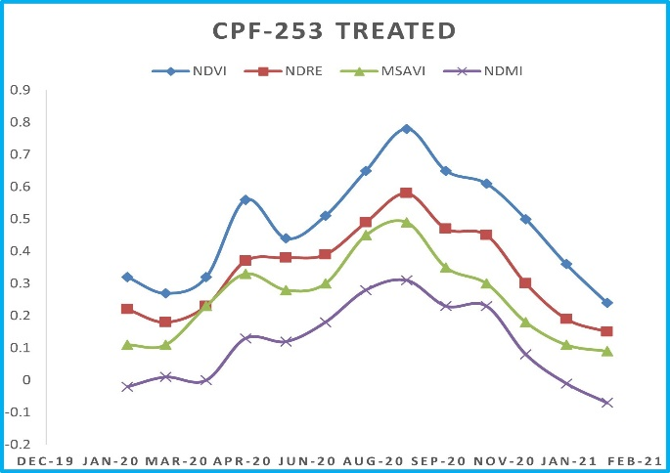
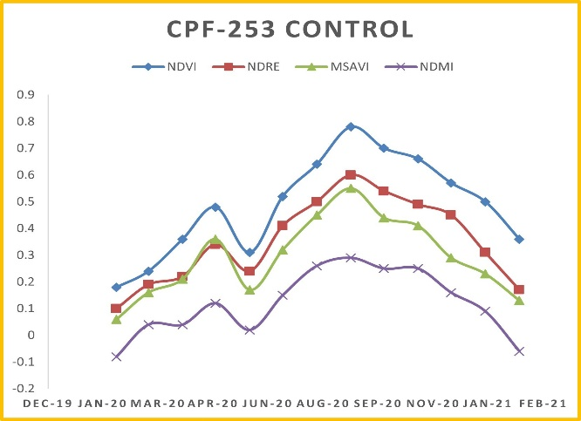
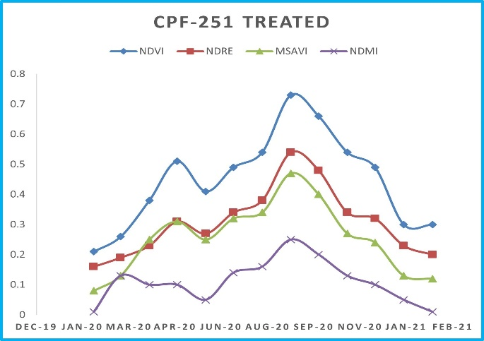
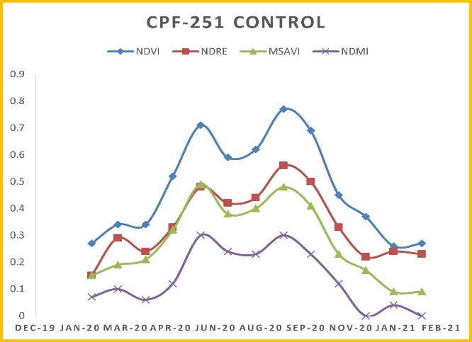
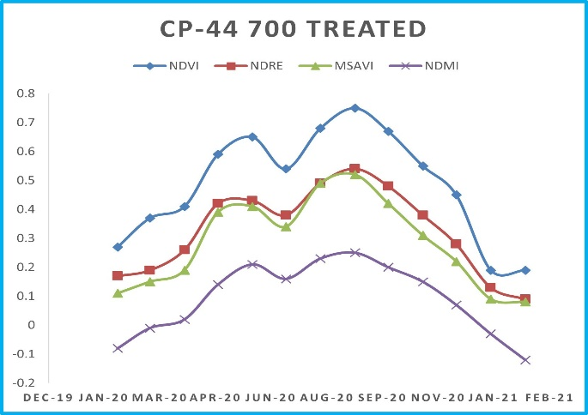
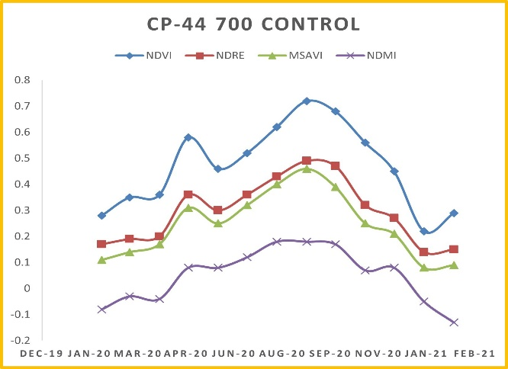
Figure 9: Vegetation indices are shown for each variety for the control plots and treated plots

Slide 15
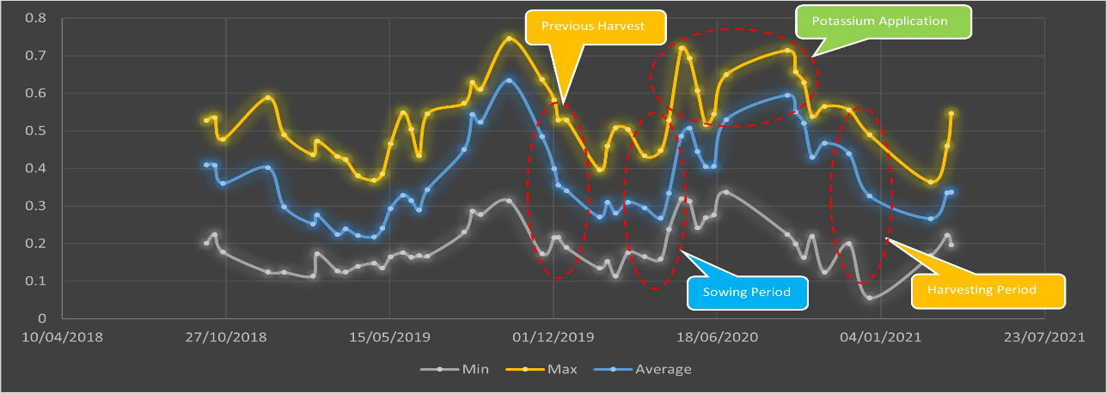
Figure 10: Annotated graph to explicitly show the sowing, harvesting and Potassium application time periods on treated plots through NDVI. The graph shows maximum, minimum and average values of NDVI during the experimental cropping season and previous cropping season

Slide 16
DISCUSSION & CONCLUSION:
Remote sensing, better field management and K application at the peak growth stage resulted in better crop performance at the study site
This is reflected in the annotated graph (Figure 7) that show the planting, harvesting and K application dates in the treated plots through NDVI
The graph shows maximum, minimum and average values of NDVI during the experimental cropping season and previous cropping season
This paper presents a novel field-level experiment for the application of K to sugarcane at the peak growth stage using a drone in Pakistan
Our experiment utilized the power of remote sensing and different vegetation indices during the crop cycle
The ongoing monitoring helped to better manage the crop compared to previous seasons

Slide 17
ACKNOWLEDGEMENT & REFERENCES:
Department of Mechatronics Engineering, College of EME, NUST – Islamabad
Department of Computer Science, COMSAT, University – Islamabad
R. Bhatt, P. Singh, O. M. Ali, A. A. H. Abdel Latef, A. M. Laing, A. Hossain, Yield and Quality of Ratoon Sugarcane Are Improved by Applying Potassium under Irrigation to Potassium Deficient Soils, Agronomy 11 (2021) 1381
N. Rasheed, W. S. Qureshi, S. A. Khan, M. A. Naqvi, E. Alanazi, AirMatch: An Automated Mosaicing System with Video Preprocessing Engine for Multiple Aerial Feeds, IEICE Transactions on Information and Systems E104.D (2021) 490–499.
S. I. Moazzam, U. S. Khan, W. S. Qureshi, M. I. Tiwana, N. Rashid, W. S. Alasmary, J. Iqbal, A. Hamza, A Patch-Image Based Classification Approach for Detection of Weeds in Sugar Beet Crop, IEEE Access 9 (2021) 121698–121715.
J. Qi, A. Chehbouni, A. Huete, Y. Kerr, S. Sorooshian, A modified soil adjusted vegetation index, Remote Sensing of Environment 48 (1994) 119–126.
E. Vermote, C. Justice, M. Claverie, B. Franch, Preliminary analysis of the performance of the Landsat 8/OLI land surface reflectance product, Remote Sensing of Environment 185 (2016) 46–56.
C. Wiegand, A. Richardson, D. Escobar, A. Gerbermann, Vegetation indices in crop assessments, Remote Sensing of Environment 35 (1991) 105–119.

Slide 18
POSTER PAPERS – ISSCT, 2023:

Slide 19
+92 321 4048133
Azeem.haider@almoiz.com

Slide 20
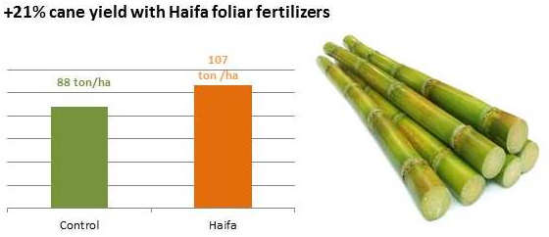
CASE STUDY
During the growth season of 2014 a trial was carried out in Goiás, Brazil, to study the effect of the enrichment of sugarcane nutrition with mid-season foliar sprays of Poly-Feed™ Mar and Haifa Bonus™. The results confirm that the foliar nutrition improved yield and increased the farmer’s net profit.
Trial setup
The trial was carried out in a trial station of the Association of Sugarcane farmers in Brazil.
Soil texture: medium
Sowing time: 25.4.2014
Irrigation: rain-fed
Results

